Slide 1
Authorize.net – Customer Information Manager (CIM)
Linda Kerrick
Director of Front Office Operations

Slide 2
Purpose
Storing patient’s information on the Auth.net server provides a convenient way for repeat patient’s to initiate future transactions with their stored information
A great percentage of revenue comes from patient payments, so it is critical to improve collections. By keeping a credit card on file for our patients it can ensure that they pay their copays and statement balances and that those payments come through promptly

Slide 3
How CIM works
Accessing CIM/placing icon on desktop
Create patient profiles for current & future use
Ability to take payment for buddy clinic patient
Patient’s email & Agile case # stored
Email Receipt
Reconciliation of days charges within CIM

Slide 4
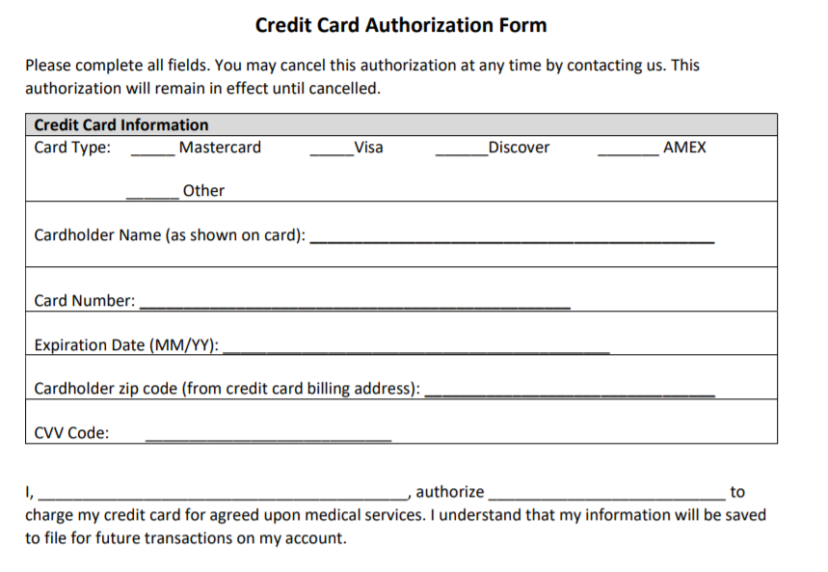
Credit Card Authorization

Slide 5

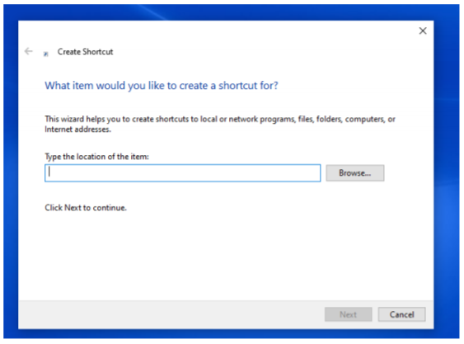
CIM Icon
Download the CIM icon to your desktop
On your desktop, right click on any blank area of your desktop
Scroll down to “New”
Scroll over to “Shortcut”
Box below populates – type this into the location field: https://www.authorize.net
Click “Next” – do NOT click browse
Name the shortcut: Auth.net CIM
Click finish

Slide 6
CIM Icon (Cont’d)
Move the new Auth.net CIM icon next to your VPOS icon on your desktop
VPOS icon = credit card swiper charges
Auth.net CIM = stored credit card charges

Slide 7
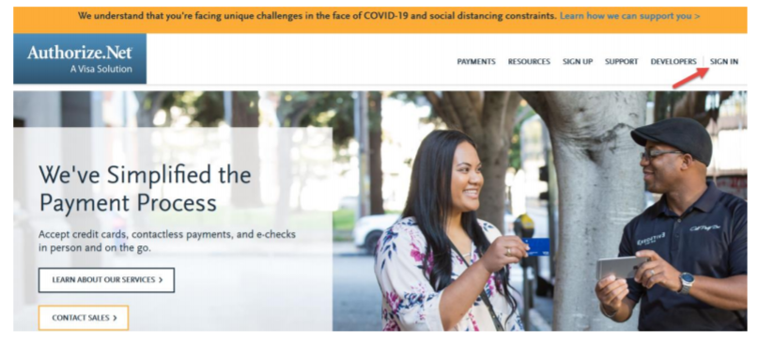
Accessing Auth.net CIM
Double click on Auth.net CIM icon
Click “Sign in”
Select “Merchants”

Slide 8
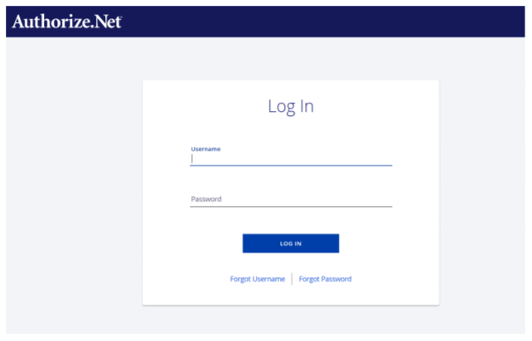
CIM Login
Log in with your CIM Partner login provided

Slide 9
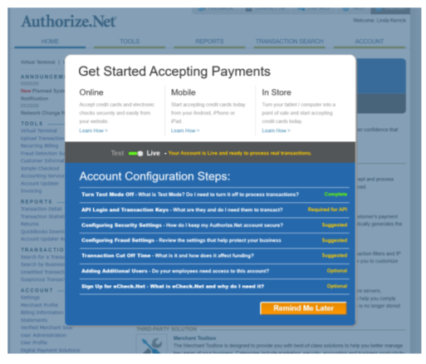
CIM Process
Once logged in, the following screen populates – you can ignore, select “remind me later”

Slide 10
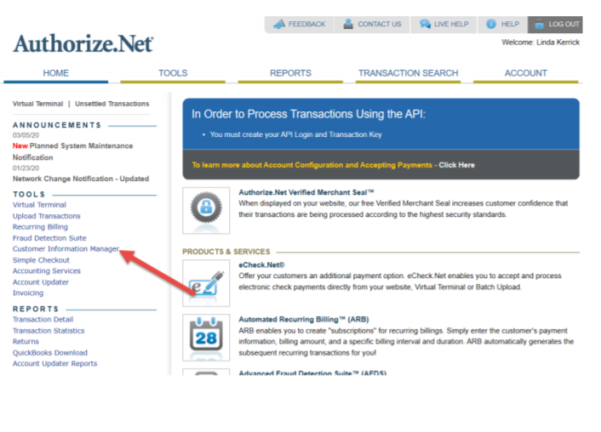
CIM Process (cont’d)
Main CIM home page
Click Customer Information Manager on L side of screen underneath tools heading

Slide 11
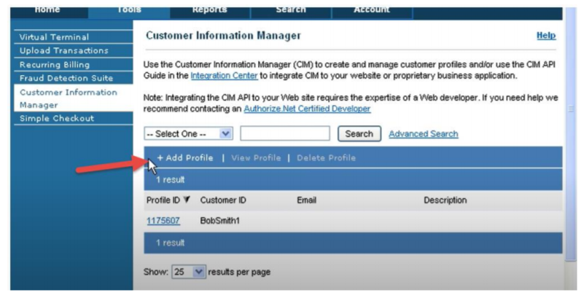
CIM Process (cont’d)
Within Customer Information Manager click “Add Profile”

Slide 12
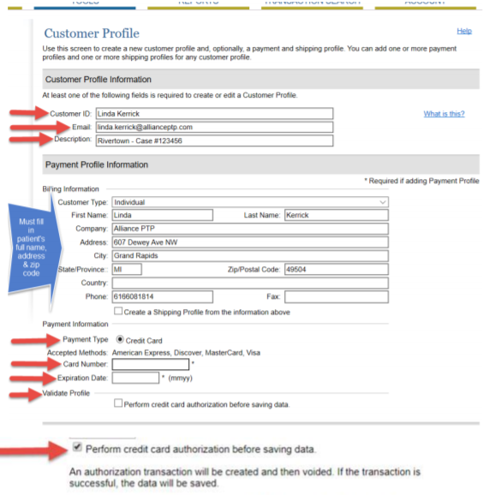
CIM Process (cont’d)
Creating a patient profile
Patient first/last name
Email is needed in order to receive receipt
Description field must be filled verbatim w/ Clinic name & Agile case #
Billing information
Payment information

Slide 13
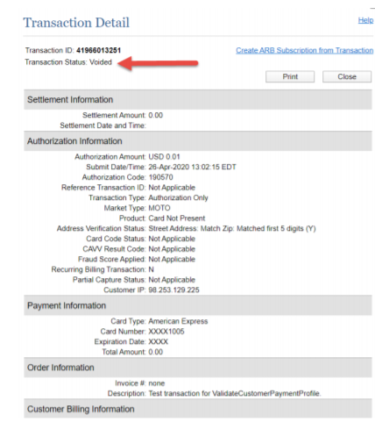
CIM Process (cont’d)
Once that card is validated the following screen appears indicating the penny charge has been voided. The patient’s information is now stored

Slide 14
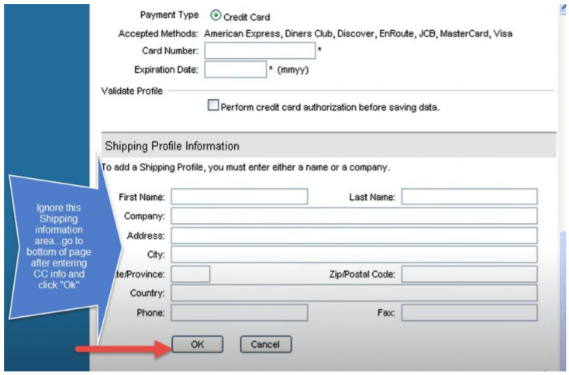
CIM process (cont’d)
Scroll to the very bottom of this page, click “ok” to store the patient’s credit card information, ignoring all shipping profile information

Slide 15
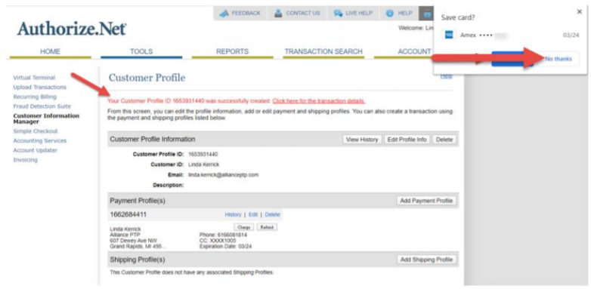
CIM process (cont’d)
Upon saving the patient’s profile information, the window appears in the right hand corner asking if you want to Save Card? Be sure to click “No thanks” – we do not want this saved to your PC

Slide 16
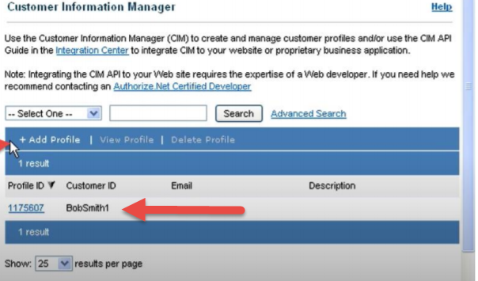
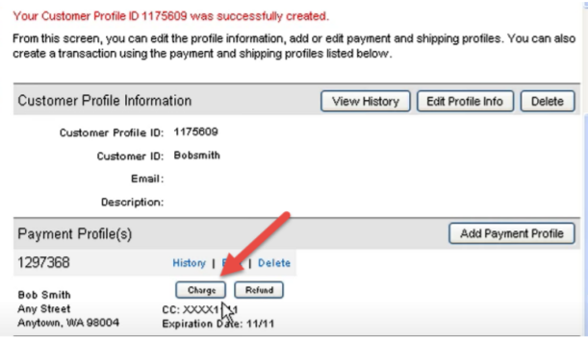
How to charge a stored credit card
After selecting your patient’s profile from the CIM screen, click “charge”

Slide 17
Thank you!

